Slide 1
B.L.D.E. Association’s V.P. Dr. P.G. Halakatti College of Engineering & Technology, Vijayapura Department of Electronics and Communication Engineering
`
Project Work Phase –II (18ECP83) Presentation
“RICE GRAIN QUALITY ANALYSIS”
Presented by:
AMAR HONAWAD
ANIL HALAGUNAKI
RAHUL BASETTI
RAHUL PATIL
Guided by:
Dr. R M MATH
30/04/2024
1
Notes:
1
CSITSS-2021

Slide 2
B.L.D.E. Association’s V.P. Dr. P.G. Halakatti College of Engineering & Technology, Vijayapura Department of Electronics and Communication Engineering
CONTENTS
Introduction
Literature Review
Proposed Work
Methodology
Advantages & Applications
Result Analysis
Conclusion
References
2
Notes:
2
CSITSS-2021

Slide 3
B.L.D.E. Association’s V.P. Dr. P.G. Halakatti College of Engineering & Technology, Vijayapura Department of Electronics and Communication Engineering
Introduction
The historical reliance on human inspectors for rice quality assessment poses challenges due to subjective decision-making, fatigue, and personal biases.
The project introduces a groundbreaking solution using image processing techniques for non-destructive and cost-effective grading of rice grains, overcoming human limitations and enhancing objectivity and accuracy.
The methodology considers both physical and chemical attributes, including grain size, shape, chalkiness, whiteness, milling degree, bulk density, moisture content, gelatinization temperature, and gel consistency, providing a holistic evaluation of rice quality.
Traditional methods for measuring grain size and shape, like grain shape tester and dial micrometer, are time-consuming and prone to human errors, necessitating a shift towards more precise and efficient approaches to meet customer expectations.
Machine vision offers a non-destructive, fast, and cost-effective alternative to traditional methods, providing precise grain quality evaluation and overcoming manual procedure limitations.
3
Notes:
3
CSITSS-2021

Slide 4
B.L.D.E. Association’s V.P. Dr. P.G. Halakatti College of Engineering & Technology, Vijayapura Department of Electronics and Communication Engineering
Literature Review
Introduction to Food Quality Detection Significance: The literature review emphasizes the critical role of food quality detection in ensuring consumer safety and satisfaction within the food industry.
Revolutionizing Food Quality Assessment: Recent advancements in machine learning and image processing techniques are highlighted for their transformative impact on the accuracy and efficiency of food quality assessment.
Collective Advances and Future Potential: The collective findings of the reviewed papers underscore the significant strides made in food quality detection through the integration of machine learning and image processing, showcasing the technology's potential to enhance food safety, quality, and overall consumer satisfaction in the industry.
The methodology considers both physical and chemical attributes, including grain size, shape, chalkiness, whiteness, milling degree, bulk density, moisture content, gelatinization temperature, and gel consistency, providing a holistic evaluation of rice quality.
4
Notes:
4
CSITSS-2021

Slide 5
B.L.D.E. Association’s V.P. Dr. P.G. Halakatti College of Engineering & Technology, Vijayapura Department of Electronics and Communication Engineering
Proposed Work
Automated Aspect Ratio Classification:
Implement image processing algorithms to automatically classify rice grains based on their aspect ratios.
Classify rice grains into categories such as Slender, Medium, Bold, and Round.
Dust Detection and Percentage Calculation:
Develop algorithms to detect dust particles on rice grains using image processing techniques.
Calculate the percentage of dust contamination in the rice sample.
Visualization of Analysis Results:
Generate visualizations, such as pie charts, to represent the distribution of rice grain types and the percentage of dust contamination.
Statistical Analysis:
Perform statistical analysis on the data, including average aspect ratio and distribution of rice grain types.
Provide insights into the overall quality of the rice sample based on the analysis results.
Integration with Web Application:
Develop a web application for users to upload rice grain images and receive automated quality analysis results.
5
Notes:
5
CSITSS-2021

Slide 6
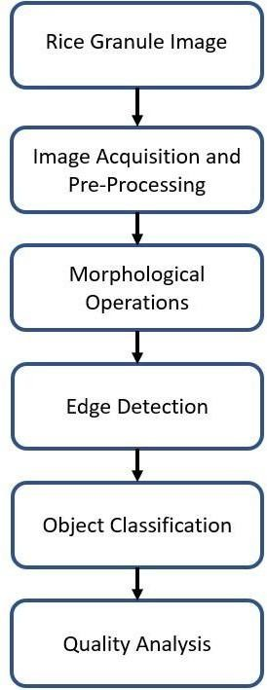
B.L.D.E. Association’s V.P. Dr. P.G. Halakatti College of Engineering & Technology, Vijayapura Department of Electronics and Communication Engineering
Methodology
Image Pre-Processing: Apply filters to eliminate noise, enhance image sharpness, and use a threshold algorithm for segmentation.
Shrinkage Morphological Operation: Employ erosion to separate interconnected features of rice grains without compromising individual integrity.
Edge Detection: Utilize the Canny algorithm for efficient identification of rice grain boundaries.
Object Measurement: Quantify rice grains, apply edge detection algorithms, and calculate length-breadth ratio using a caliper.
Aspect Ratio Formula: Calculate aspect ratio using the formula height / width, normalized to a positive value if less than 1.
Object Classification: Execute classification based on standard, measured, and calculated outcomes to categorize rice seeds into Slender, Medium, Bold, or Round.
Quality Analysis: Categorize rice grains into Slender, Medium, Bold, or Round based on specific aspect ratio ranges.
Fig 1: Block Diagram of Proposed Model
6
Notes:
6
CSITSS-2021

Slide 7
B.L.D.E. Association’s V.P. Dr. P.G. Halakatti College of Engineering & Technology, Vijayapura Department of Electronics and Communication Engineering
Advantages
Quality Assurance: Confirms rice meets industry standards, ensuring product consistency and consumer satisfaction.
Marketability: Identifies high-quality rice, enabling premium pricing and increased profitability for producers and traders.
Consumer Safety: Detects harmful contaminants like pesticides and mycotoxins, ensuring rice is safe for consumption.
Processing Optimization: Evaluates parameters like milling degree and chalkiness to optimize processing for better yield and quality.
Research and Development: Provides valuable data to support breeding programs and other R&D efforts, fostering the development of superior rice varieties.
7
Notes:
7
CSITSS-2021

Slide 8
B.L.D.E. Association’s V.P. Dr. P.G. Halakatti College of Engineering & Technology, Vijayapura Department of Electronics and Communication Engineering
Applications
Grain Quality Assessment: Measures size, shape, and colour for classification based on standards.
Sorting and Grading: Automates segregation for different market grades.
Paddy Quality Monitoring: Evaluates physical attributes of paddy rice before milling.
Marketability and Consumer Preference: Analyzing rice quality allows producers to meet consumer preferences and market demands.
Food Safety and Quality Control: Analysis ensures that rice meets safety standards and quality requirements for human consumption.
8
Notes:
8
CSITSS-2021

Slide 9
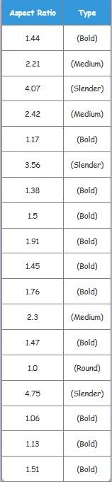
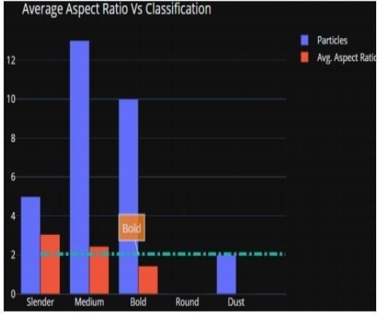
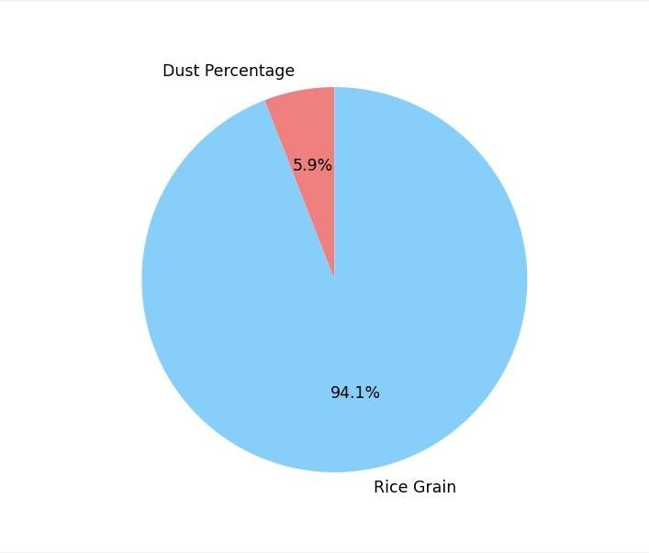
B.L.D.E. Association’s V.P. Dr. P.G. Halakatti College of Engineering & Technology, Vijayapura Department of Electronics and Communication Engineering
Result Analysis
A) Objective:
Automate rice grain classification and quality assessment to reduce manual labor.
B) Method:
Developed a web app using Python Flask to process rice grain images and classify based on aspect ratios.
C) Results:
Pie chart for dust and rice grain percentages.
Grouped bar chart showing total grains and average aspect ratio.
Classification into Slender, Medium, Bold, and Round.
D) Innovation:
Goes beyond detection and counting, adding quality analysis.
E) Impact:
Streamlines rice quality assessment, offering a more efficient solution.
Fig 2: Aspect Ratio vs Classification
Fig 4: Classification of Rice in Categories
Fig 3: Pie Chart
9
Notes:
9
CSITSS-2021

Slide 10
B.L.D.E. Association’s V.P. Dr. P.G. Halakatti College of Engineering & Technology, Vijayapura Department of Electronics and Communication Engineering
Conclusion
Distinctive Approach: The project uniquely classifies rice grains and analyzes their quality, setting itself apart from existing works by allocating grains to specific categories.
Efficiency in Methodology: Time and Effort Reduction: Our methodology expedites the process, saving time and human effort compared to manual analysis.
Image Analysis Algorithms: Applied to randomly arranged rice grain images, enhancing overall efficiency.
Precision in Grain Assessment: Edge Detection Precision: Pinpoints boundary regions through edge detection, determining endpoints for individual grains.
Caliper-Based Measurement: Measures length and breadth for calculating the length-breadth ratio.
Efficient Grain Quality Evaluation: Algorithmic Efficiency: Algorithms efficiently evaluate grain quality based on size.
Advantages: Expedited process, minimal time requirement, cost-effectiveness, and superior performance compared to manual methods.
10
Notes:
10
CSITSS-2021

Slide 11
B.L.D.E. Association’s V.P. Dr. P.G. Halakatti College of Engineering & Technology, Vijayapura Department of Electronics and Communication Engineering
v
References
[1] Jagdeep Singh Aulakh, Dr. V.K. Banga, “Grading of rice grains by image processing”, International Journal of Engineering Research & Technology (IJERT), Vol. 1 Issue 4, June 2012.
[2] Chetana V. Maheshwari, Kavindra R. Jain, Chintan K. Modi, “Non-destructive Quality Analysis of Indian Gujarat-17 Oryza Sativa SSP Indica (Rice) Using Image Processing”, International Journal of Computer Engineering Science (IJCES), Vol. 2 Issue 3, March 2012.
[3] Bhavesh B. Prajapati, Sachin Patel, “Classification of Indian Basmati Rice Using Digital Image Processing as per Indian Export Rules”, International Research Journal of computer Science Engineering and Applications, Vol. 2 Issue 1, January 2013.
[4] S. Kanchana, S. Lakshmi Bharati, M. Ilam ran and K. Singaravadivel, “Physical Quality of Selected Rice Verities”, World Journal of Agriculture Sciences, pp. 468-472, 2012.
[5] Bhupinder Verma, “Image Processing Techniques for Grading & Classification of Rice”, International Conference on Computer and Communication Technology (ICCCT), pp. 220-223, 2012.
11
Notes:
11
CSITSS-2021

Slide 12
B.L.D.E. Association’s V.P. Dr. P.G. Halakatti College of Engineering & Technology, Vijayapura Department of Electronics and Communication Engineering
THANK YOU
12
Notes:
12
CSITSS-2021

